Slide 1
BLOCKCHAIN CRASH COURSE
Sage Franch, CTO at Crescendo
@theTrendyTechie | sage@getcrescendo.co

Slide 2



Slide 3
BLOCKCHAIN What is it? How does it actually work? Why should I care? How can I participate?

Slide 4
Level.set(0);
Notes:
Blockchain in terms of bitcoin
Bitcoin aims to decentralize currency and replace traditional currency; Ethereum aims to decentralize the app world
Ether is the currency that runs on Ethereum – you need to spend ether to execute smart contracts, which is what gives ether its value

Slide 5


Slide 7
BLOCK 0
Transaction
BLOCK 1
Transaction
Hash(Block 0)
BLOCK 1
Transaction
BLOCK 2
Transaction
Hash(Block 1)

Slide 8
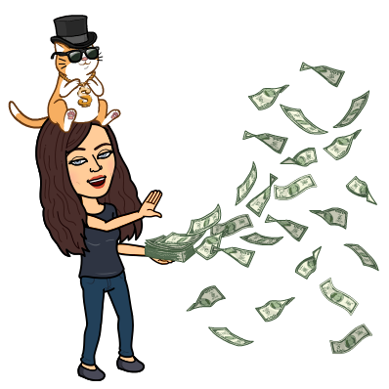
Tx

Slide 9
Tx

Slide 10
Tx

Slide 11
Network protocol - how do peers communicate?
Consensus protocol - how are decisions made?
Transaction protocol - what makes transactions valid?

Slide 12






PROOF OF WORK
PROOF OF STAKE

Slide 13

Decentralization
TRUST
+ Immutability

Slide 15

Notes:
Acquired MediaChain Labs last year
Music rights attribution
Cryptocurrency

Slide 16
Notes:
Tracking medical records securely for telemedecine

Slide 17
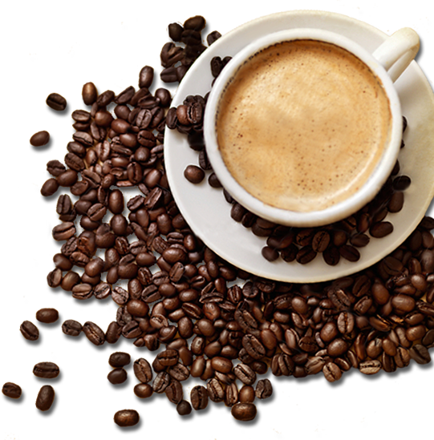
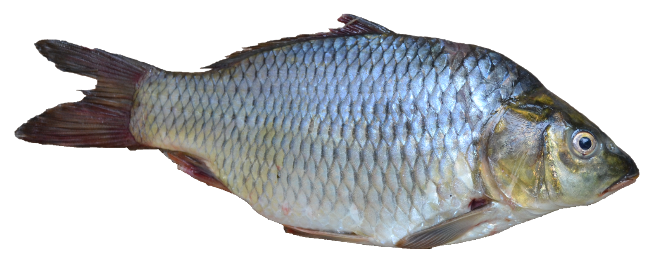



Slide 18
Blockchain with JS

Slide 19
1. JS as a front end
2. JS driving the car
Solidity
Ethereum
Lotion.js
Tendermint

Slide 20
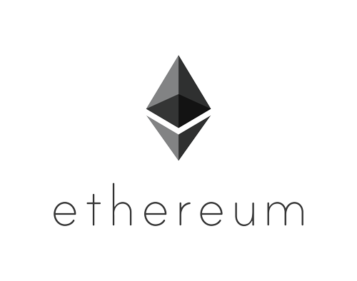
Notes:
Ethereum is both a blockchain network and a technology. The Ethereum networks employees the technology, but one does not have to subscribe to the Ethereum network in order to use the Ethereum technology. It allows users to create their own blockchains for whatever reason he or she sees fit, and that blockchain can be publicly shared or privately shared depending on how it is applied.
Ethereum is a general purpose blockchain that still has all the concepts of those designed for cryptocurrencies. Ethereum nodes mine “Ether” as the currency that is exchanged in Ethereum networks.
Secure electronic voting
Identity management
Bond trading
Electronic banking
Real-estate transactions
Supply-chain management

Slide 21


SMART CONTRACTS

Slide 22
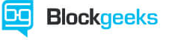
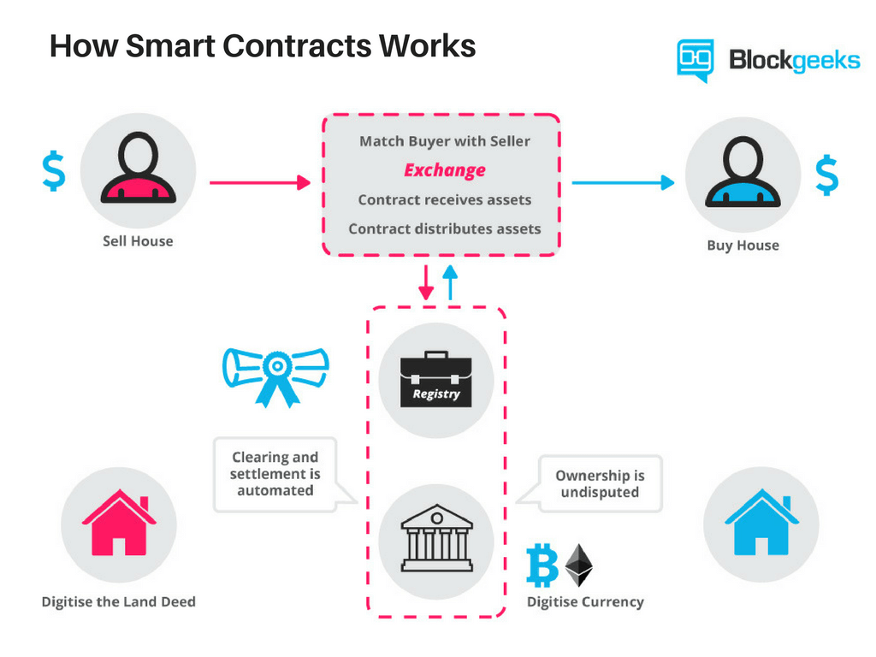

Smart Contract Example
Notes:
Real estate sale example

Slide 23

Smart Contracts

Slide 24
Ethereum – blockchain technology
Solidity – smart contract language
Truffle –
framework for creating and deploying smart contracts
Metamask – browser-based crypto wallet
Ganache – personal blockchain dev environment

Slide 25
Lotion.JS
https://lotionjs.com/

Slide 27
github.com/thetrendytechie /bed-and-blockchain-start /lotion-peer-economy

